Slide 1
Basic Details of the Team and Problem Statement
Team Member Details
Team Member 1 Name: Agrima Shukla
Branch: Btech Year: 3rd
Team Member 2 Name: Naman Badgaiyan
Branch: Btech Year: 3rd
Team Member 3 Name: Shivang Raj Shivhare
Branch: Btech Year: 3rd
Team Member 4 Name: Yash Daheriya
Branch: Btech Year: 3rd
Problem Statement Title: Online integrated platform for projects taken up by the students of various universities/colleges.
Team Name: Binary Brainers
Institute Code (AISHE): C – 36022
Institute Name: Lakshmi Narayan College of Technology
Theme Name: Smart Education

Slide 2
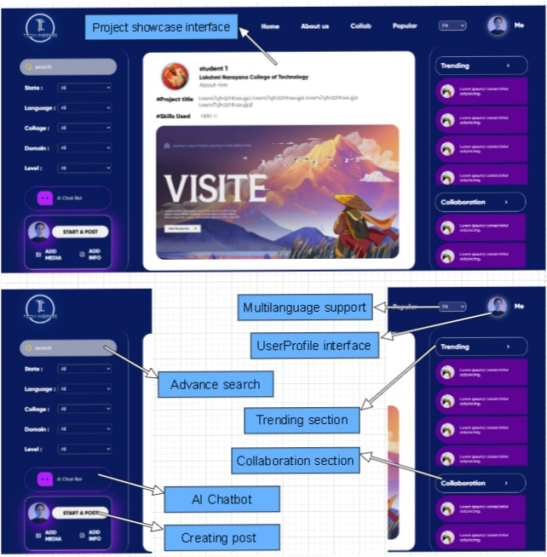















Screenshot of TechInspire:
Idea/Approach Details
PROJECT DESCRIPTION (TECHINSPIRE):
◆
Our website TECHINSPIRE serves as a centralized comprehensive project repository where students from different universities/colleges across India can
upload and showcase their academic projects.
◆
It promotes comprehensive project analysis, global knowledge exchange, user engagement and collaboration, promotion of network for students, preparation for the workforce, improves quality of projects and helps in enhancing the quality of higher education in India through cross-university research opportunities.
◆
TECHINSPIRE has Collaboration Interface where students can work together to enhanced learning outcomes, inclusion of Trending Section for showcasing innovation and community engagement and have Interactive and Responsive data visualization through flexible UI/UX.
Technology stack used in TechIspire:
FRONT END:
BACKEND:
DATABASE:
ADDITIONAL FEATURES:
◆
We offer additional features like Multi-Language support that makes it versatile throughout India, AI Chatbot which helps users to resolve queries , Advance Search and Filtration options which help user to get projects from specific area or domain.
◆
We use Recommendation Engine that suggests projects, research papers, or collaborators based on a user's interests, previous interactions, and profile information and also have Notification and Alerts feature to give updates.

Slide 3
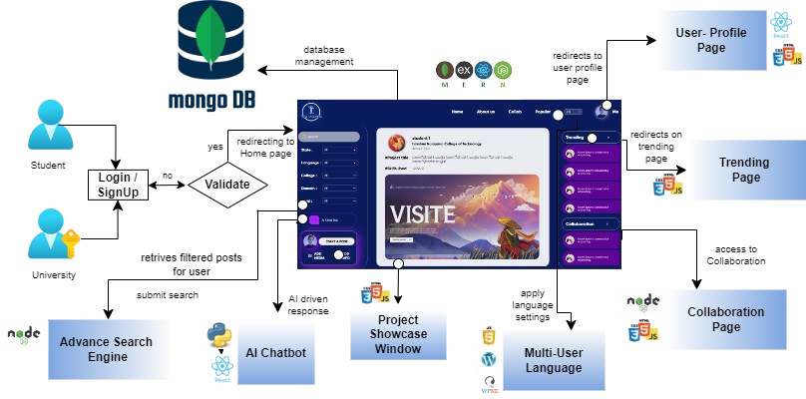
Idea/Approach Details
Use Case diagram of TechInspire:
FUTURE SCOPE:
◆
Online Courses and Certifications: Partner with educational content providers to offer online courses and certifications related to project topics. Take a commission from course sales.
◆
Internship and Job Opportunities: Partner with companies and organizations to provide internship and job listings relevant to students' fields of study.
◆
Scholarship Opportunities: Aggregate scholarship opportunities from various sources and provide a section for students to search and apply for scholarships.
Colleges and universities can also provide scholarship to there top colleges.

Slide 4
Show Stoppers in TechInspire:
Dependencies of TechInspire:
Web Hosting and Server Infrastructure: A reliable hosting service and server infrastructure are fundamental to make it accessible on the internet to store and serve our website files and data.
●
Advanced Filtering: The advanced filtering feature allows users to refine project searches based on specific criteria, making it easier to find relevant projects.
AI Chatbot: The AI chatbot can assist users with inquiries, provide project recommendations, and offer support, enhancing the overall
user experience.
Multilanguage Support: Offering the website in multiple languages ensures accessibility to a broader user base, including non-English speakers.
Recommendation Engine: This system suggests projects to users based on their interests, past activity, and user profiles to helps users
discover relevant and interesting projects they might have otherwise missed.
Notification and Alert Feature: project categories receive
notifications when there are updates, new comments, or changes. Collaboration Invitations: Send notifications when a user is invited to collaborate on a project, ensuring they don't miss out on potential teamwork opportunities.
New Project Uploads: Notify users when new projects matching their interests or criteria are uploaded to the platform.
Peer Review and Feedback System: Implement a peer review and
feedback system where users can provide constructive feedback on
each other's projects and helps improve the overall quality of projects.
◆
●
◆
Database Management System (DBMS):DBMS is used to store, retrieve, and manage project data, user profiles, and other essential information. It's the backbone of our platform.
●
◆
AI Chatbot Framework and NLP Tools: For the AI chatbot feature, we depend on the chatbot framework and natural language processing tools without which, the chatbot won't function as an AI-driven support tool.
●
●
◆
Scalable Cloud Services: When our project experiences growth, we'll relay on scalable cloud services to handle increased traffic and data. Without this scalability, our website would become slow or unresponsive during high- traffic periods.
●
●
◆
Security and Data Privacy Tools: Data privacy regulations are essential for user trust and data protection. Neglecting security measures can lead to vulnerabilities
and data breaches.
●
Revenue Stream:
◆
Quality Control and Testing Tools: Implement comprehensive quality control and testing processes to identify and fix issues, ensuring a smooth and reliable user experience on our education-focused project
sharing website.
◆
Monetizing through subscription and premium models Job boards
Sponsored projects
Freelancing facility for students.
◆
◆
◆

